Slide 1
Final Report
I-Hsuan WU
2019/8/9

Slide 2
Predicting annual dengue incidence by using climate data and imported cases data in Taiwan
Supervisor: Dr. YUAN

Slide 3
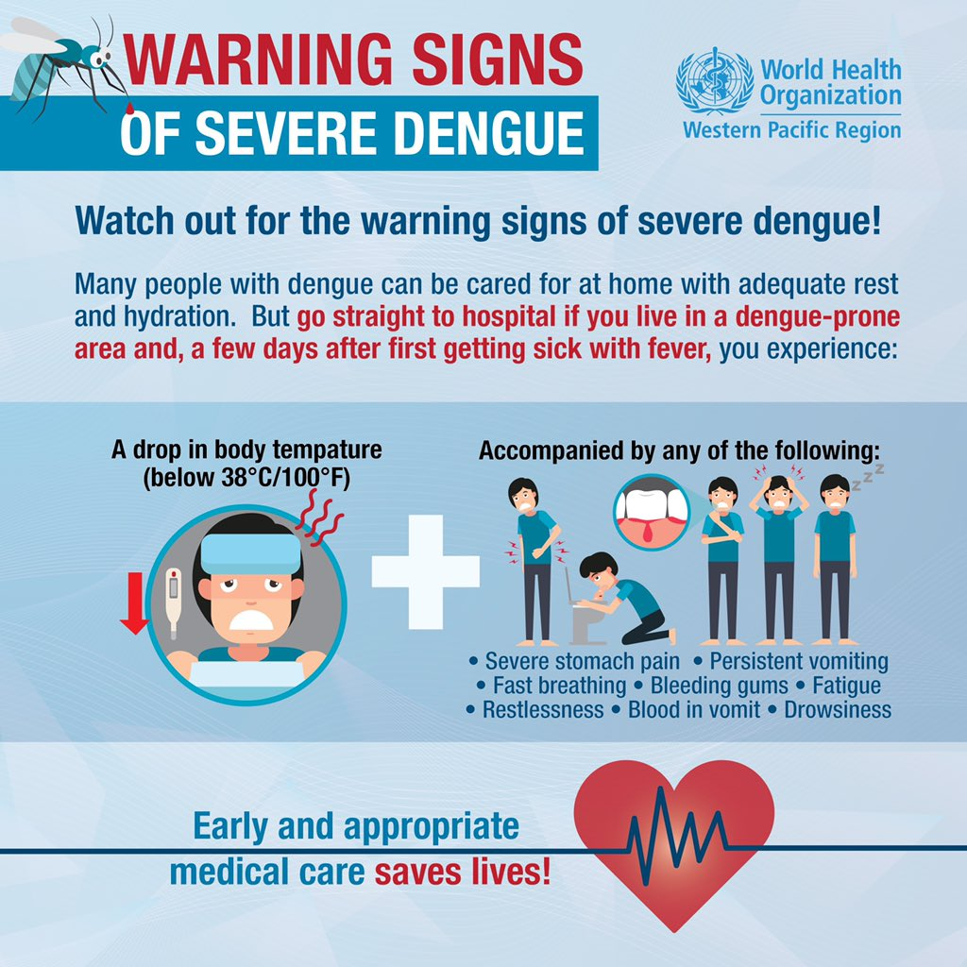
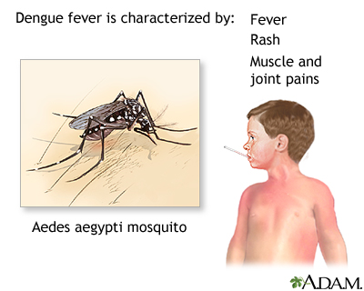
Dengue

Slide 4
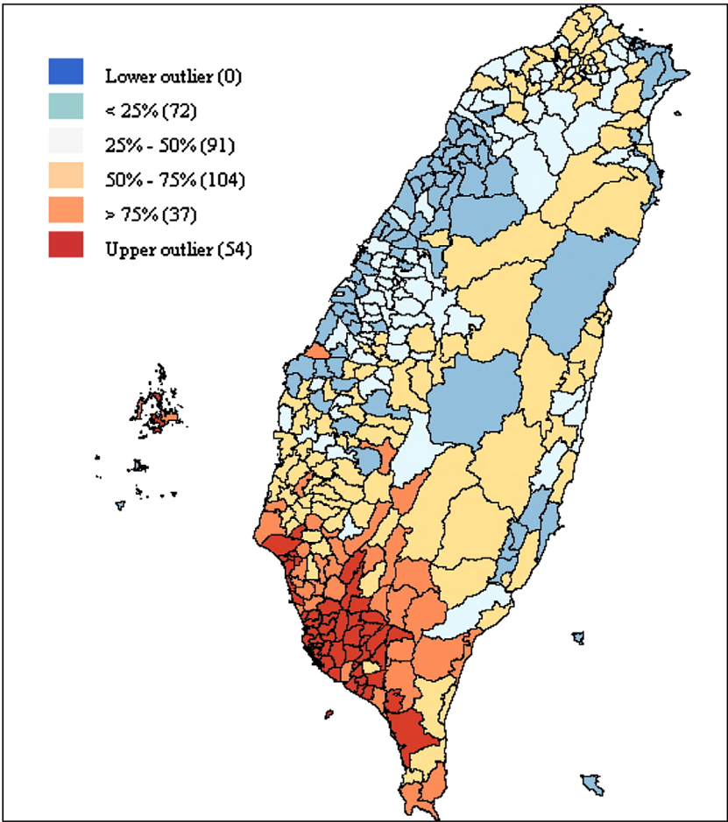
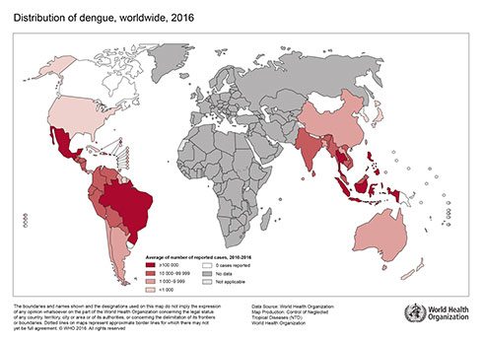
Dengue Distribution
1998–2002
Higher temperature and urbanization affect the spatial patterns of dengue fever transmission in subtropical Taiwan

Slide 5
Construct model to predict dengue incidence
Model construction
Variable selection
Comparing models using Q-Q plot

Slide 6
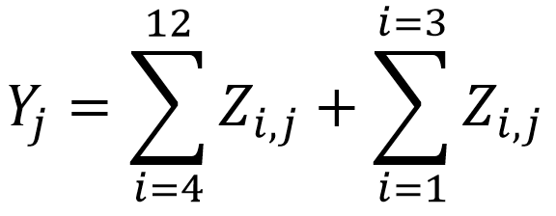
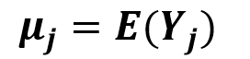
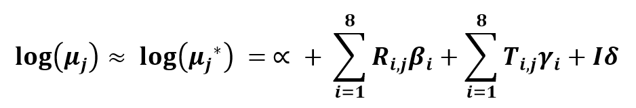
Model construction -Poisson Regression Model
Poisson regression model is a generalized linear model form of regression analysis used to model “count data”.
denotes the total number of dengue cases in jth year, where i = 1, …, 12 and _{j} = 1, 2, 3, … 17(1999, 2000, 2001, … 2015)

Slide 7
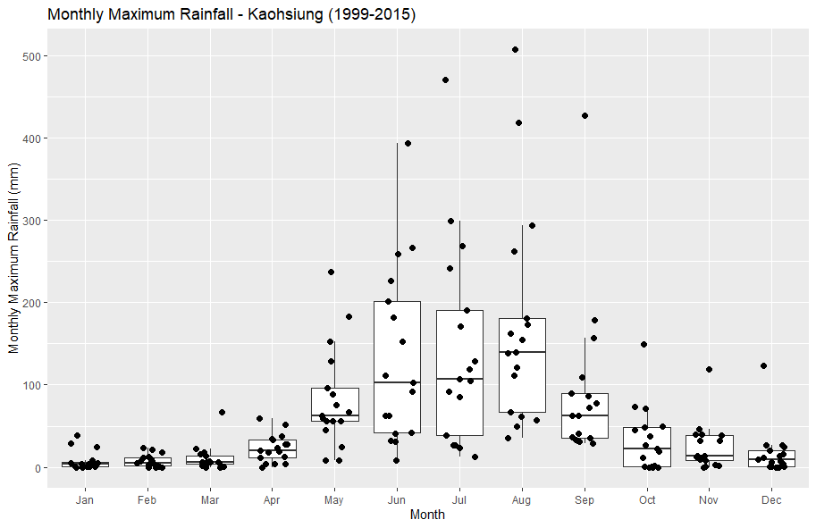
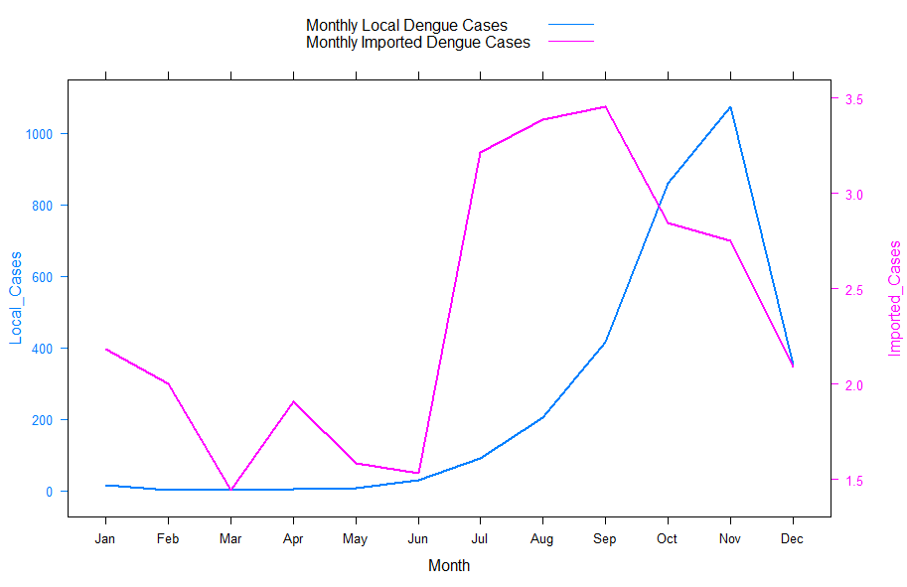
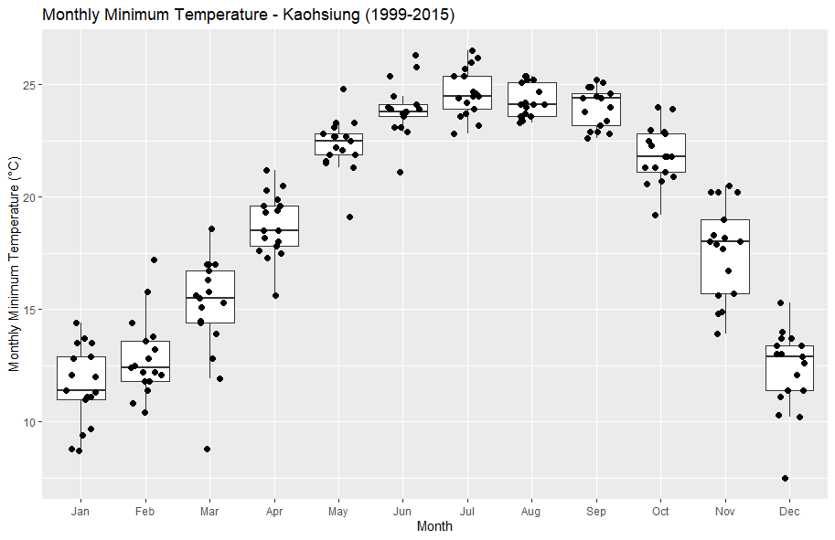
Weather and Dengue Cases in Kaohsiung

Slide 8
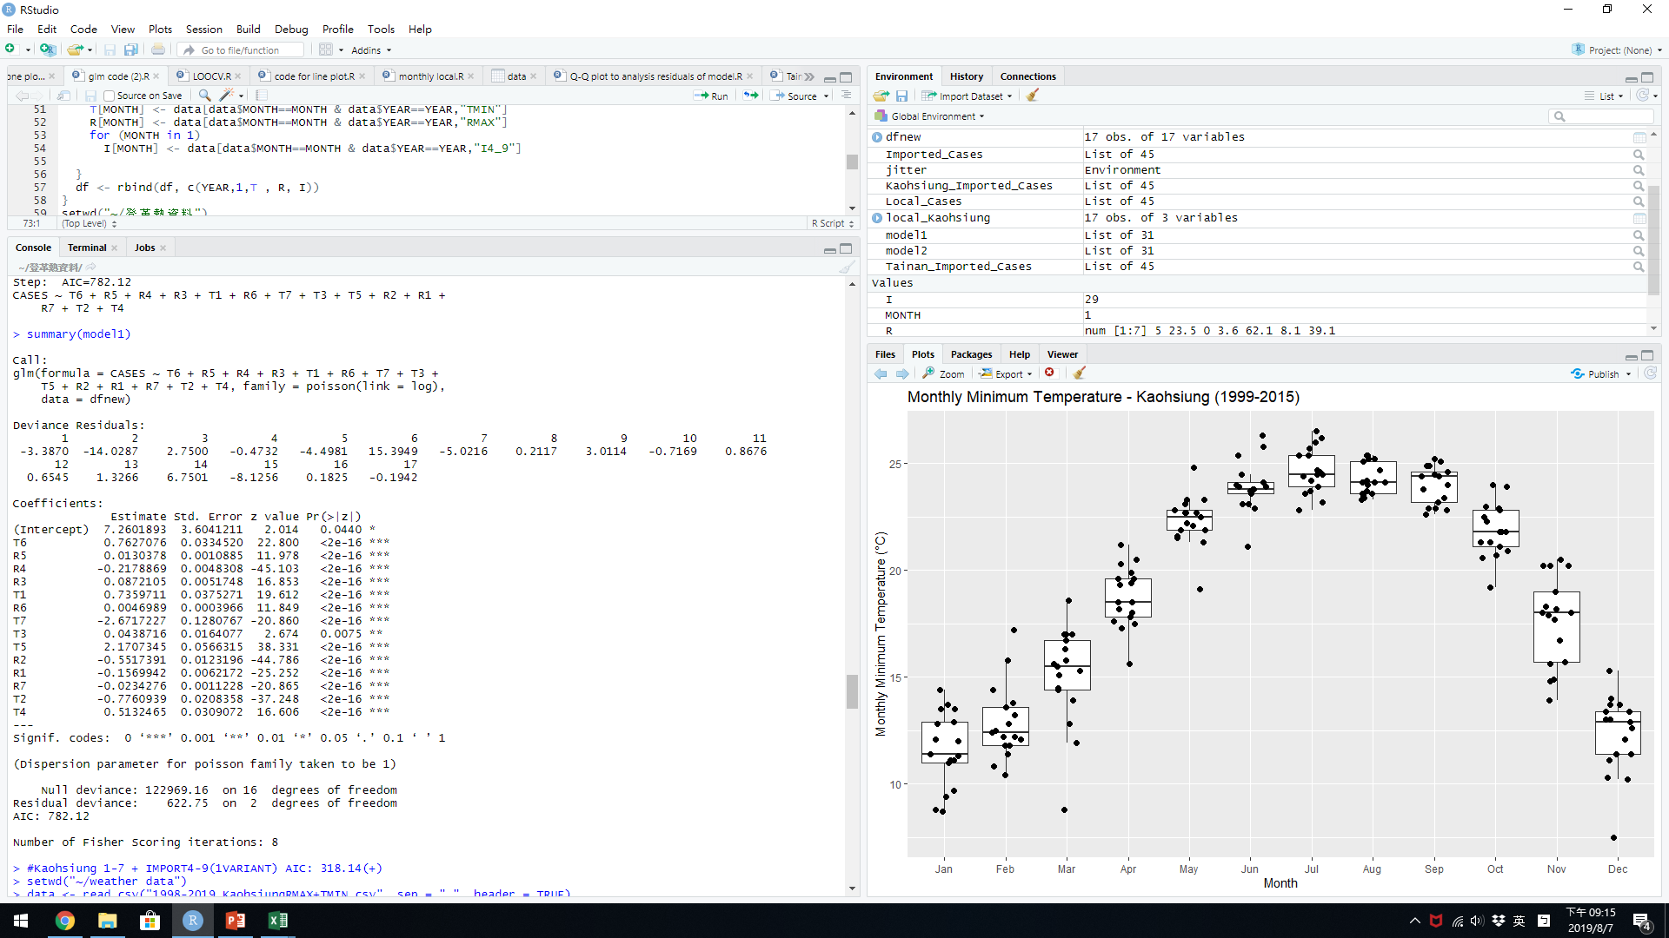
Variable selection (Climate variant - Kaohsiung)
The Akaike information criterion (AIC) estimates the relative amount of information lost by a given model:
the less information a model loses, the higher the quality of that model.

Slide 9
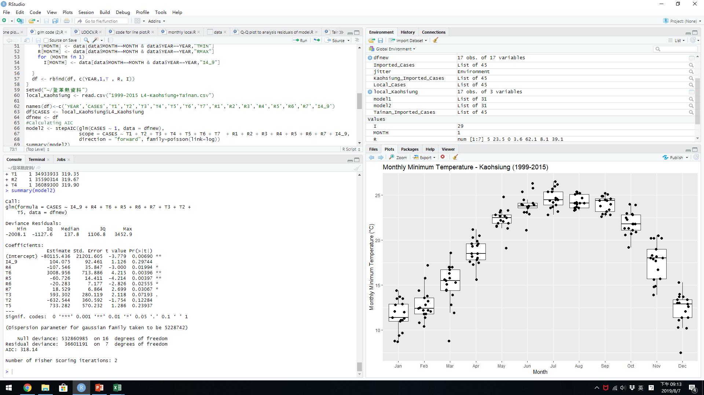
Variable selection (Climate variant + Imported cases variant - Kaohsiung)
When imported cases variant is added, the model is more fitted significantly.

Slide 10
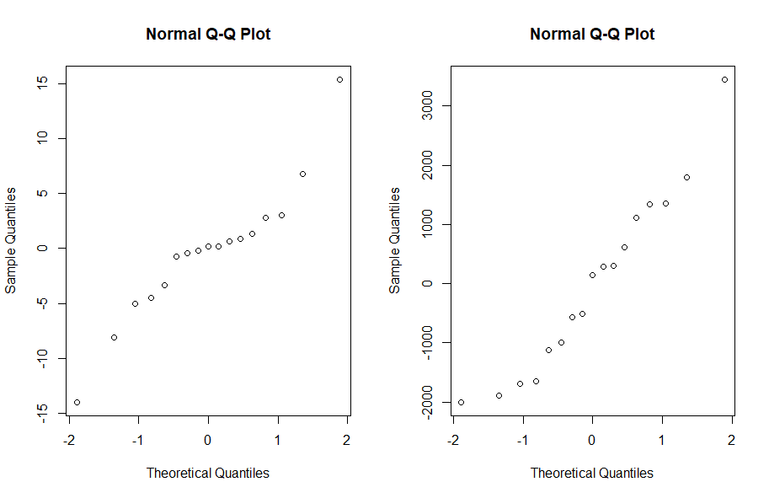
Comparing models using Q-Q plot
When imported cases variant is added, the model is more fitted.
Climate variant Climate variant + Imported cases variant
The residuals are essentially the difference between the predicted value and the actual value.
Normal Q-Q Plot: used to assess if your residuals are normally distributed.

Slide 11
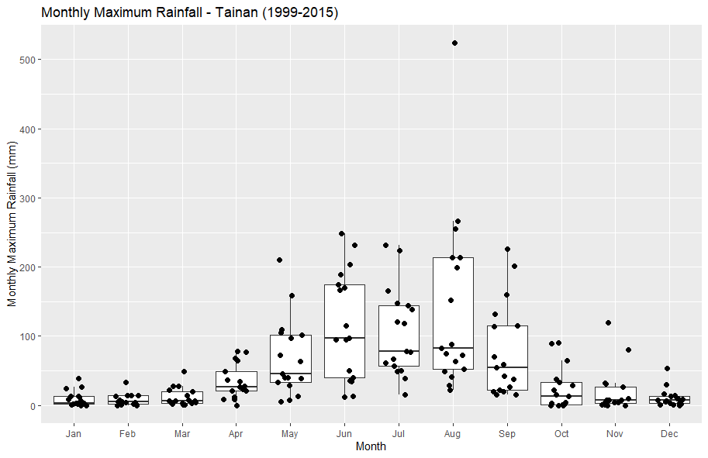
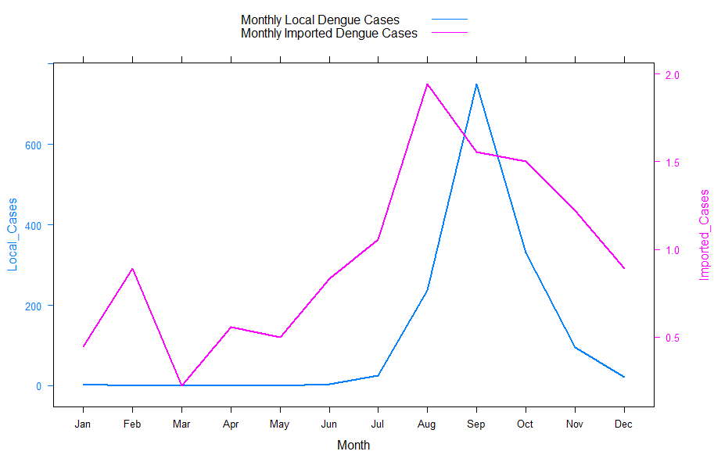
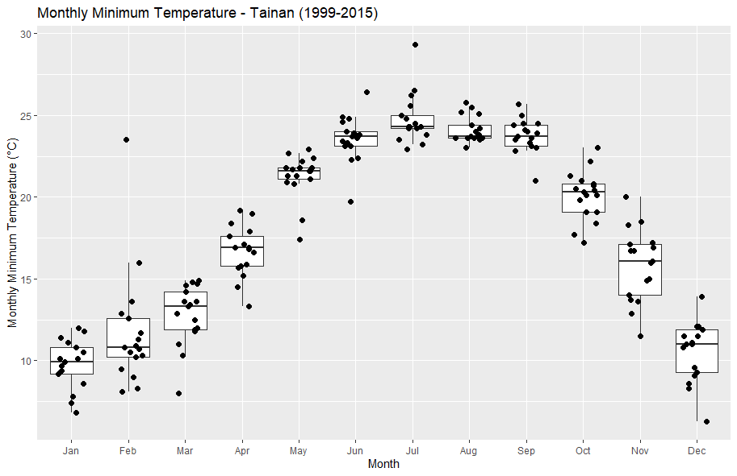
Variable selection(Tainan)

Slide 12
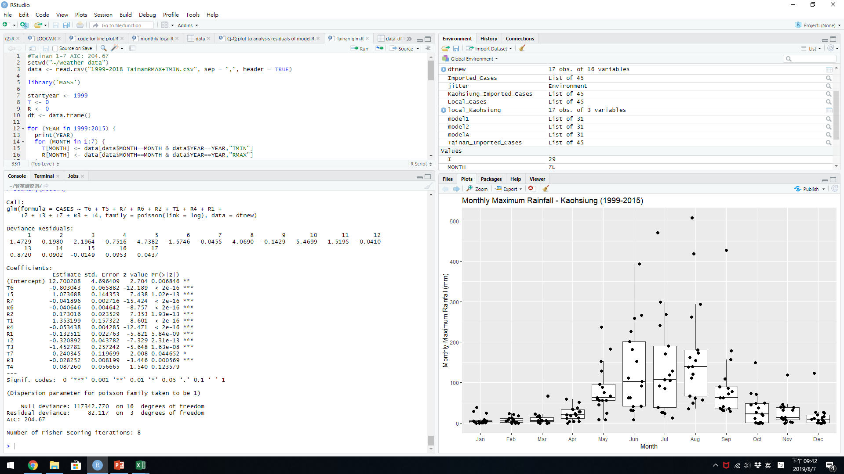
Variable selection (Climate variant - Tainan)

Slide 13
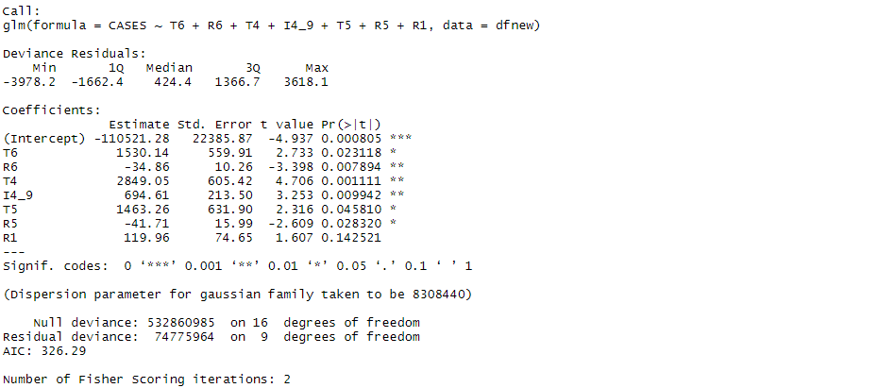
Variable selection (Climate variant + Imported cases variant - Tainan)
When imported cases variant is added, the fitting of model is no different so much.

Slide 14
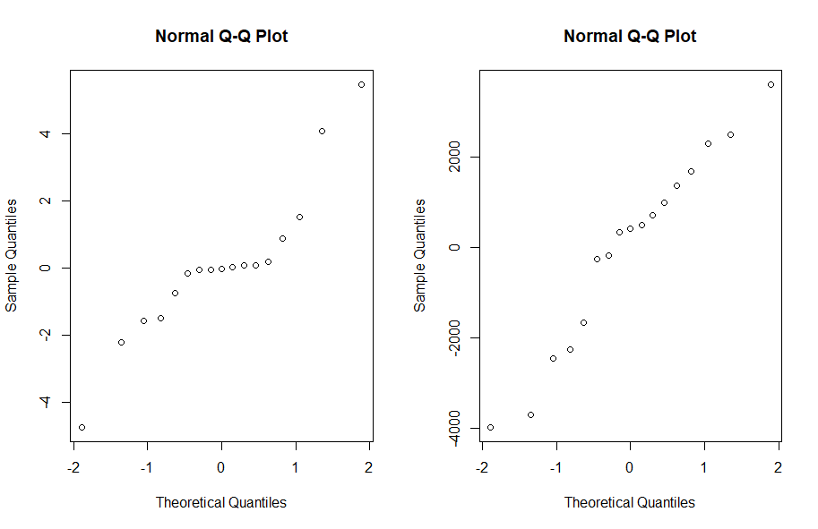
Comparing models using Q-Q plot
When imported cases variant is added, the residuals of model more follow Normal distribution more.
Climate variant Climate variant + Imported cases variant

Slide 15
Conclusion
We can use climate data and imported cases data to predict dengue incidence in Taiwan.
Predicting the incidence of dengue can help to prepare for, manage and control the epidemic.

Slide 16
The Cultural and Industrial Visits

Slide 17


